Slide 1
Bell-Ringer ?:
Does human nature require that we build safeguards into our government to protect us from our leaders?

Slide 2

Separation of Powers
& Checks and Balances

Slide 3

Separation of Powers
Legislative Power
Make laws
Executive Power
Carry out laws
Judicial Power
Apply laws to situations/interpret

Slide 4

The Fear of Too Much Power
Framers of Constitution feared too much power in leader or branch
Writings of Baron de Montesquieu inspired them

Slide 5
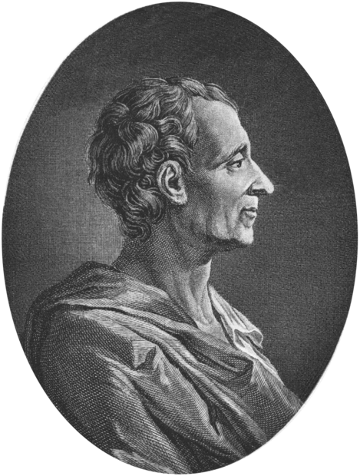
Baron de Montesquieu
No liberty if executive powers and legislative are same person
3 powers should be separate from each other but also dependent on each other
In this way, no power could become stronger than others

Slide 6
Separation of Powers
 | Legislative Branch | Executive Branch | Judicial Branch
Federal Government | Parliament | Government | High Courts Federal Courts
Who? | Queen (GG) Senate House of Reps | Queen, and Prime Minister | Judges

Slide 7
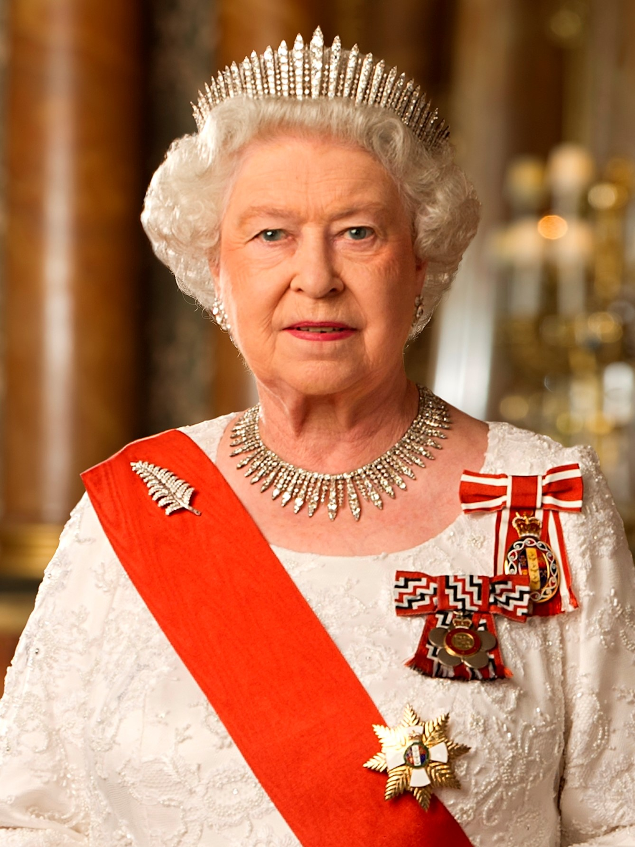
Checks and Balances- Executive
Checks on Legislative | Executive Branch | Checks on Judiciary
Implement laws passed by the legislative | Also known as the Government Consists of: Queen, Ministers and Prime Minister Puts Laws into action and manage countries laws | Appoints judges to the courts

Slide 8

Checks and Balances-Judicial
Checks on Executive | Judicial Branch | Checks on Legislative
Can declare actions of the executive as unlawful | Known as the courts Judges the countries laws. Consists of: high court | Can make unconstitutional laws invalid

Slide 9

Checks and Balances- Legislative
Checks on Judiciary | Legislative Branch | Checks on Executive
Can remove judges for misconduct and pass laws to override court decisions | Parliament Makes and ammends the laws of the country Consists of the Queen, Senate and House of Representatives | Can refuse to pass laws they find unacceptable

